Slide 1
Sentiment Analysis
NLP
TERMINATION
BELLY
German Baltazar, Anyinssan Nava, David Lizama
06/20/2022

Slide 2
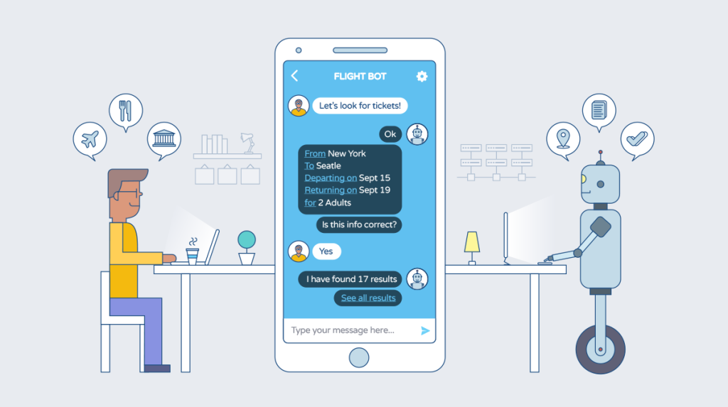
Context
Intelligent systems that require interaction with a human are usually required to follow a conversation as human as possible.
This task is achieved by determining the context of the conversation prior to the selection of the generated phrase.

Slide 3
Objective
Classify daily-life phrases into three different categories:
01
02
03
Regular Chat
Inform
Question
Deploy a functional API with the trained models

Slide 4
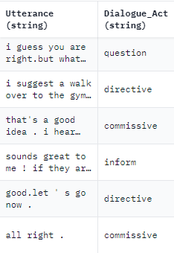
Dataset
Subcategory of the sequence labelling evaluation for spoken language (SILICONE) that cover daily life situations.
Four categories:
Commissive
Directive
Inform
Question
The first two were joined into the regular chat class.
Trained two different neural network models: ANN and ALBERT
Class 2: Question
Class 0: Chat
Class 0: Chat
Class 1: Inform
Class 0: Chat
Class 0: Chat

Slide 5
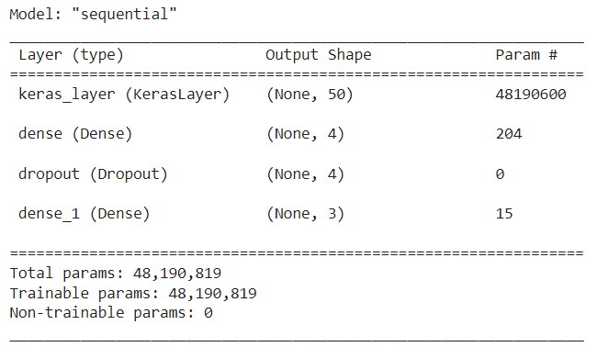
ANN
Architecture
Simplifying the model (one hidden layer and 4 neurons).
Regularization and dropout.
Embedding using low dimensions.
"https://tfhub.dev/google/tf2-preview/nnlm-en-dim50/1"
Training 20 epochs
Optimizer: Adam
Dropout of 30%

Slide 6
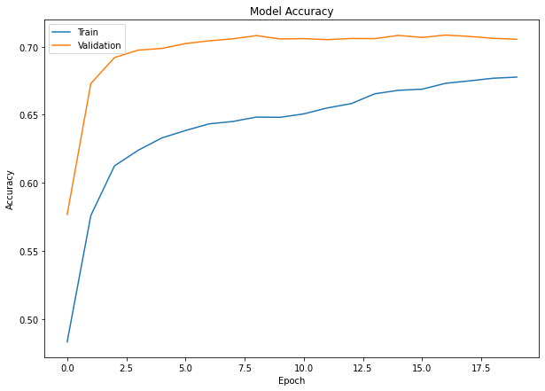
Results
Test accuracy = 73%
Underfitting model

Slide 7
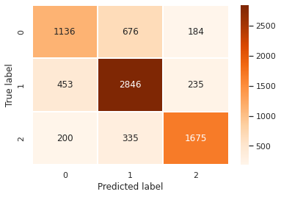
Results
Several observations were misclassified between Talk: 0 and Informative: 1.
Accuracy of 0.73 in Test set.
A few false negatives when the true label is a question.

Slide 8
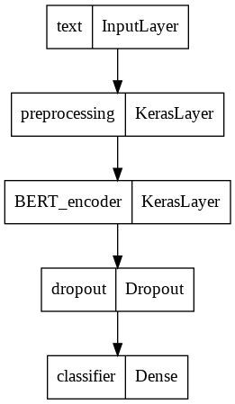
ALBERT
Architecture
Transfer learning of the ALBERT model
Frozen weights
ALBERT embeddings
"https://tfhub.dev/tensorflow/albert_en_preprocess/3"
Training 13 epochs
Optimizer: AdamW
Dropout of 10%

Slide 9
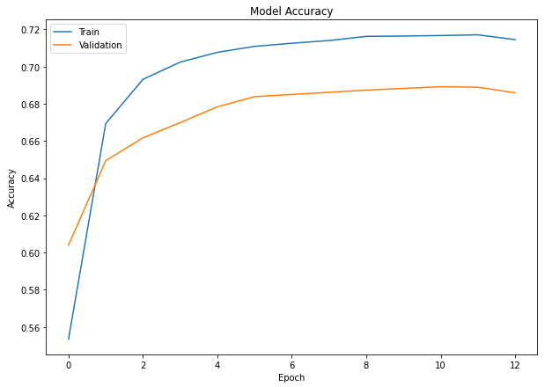
Results
Test accuracy = 73.12%
Computationally expensive

Slide 10
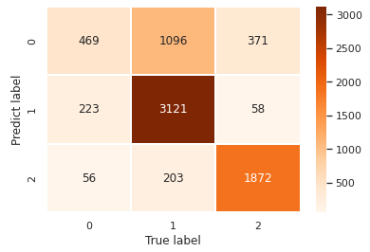
Results
Low number of epochs with low accuracy
Difficult to separate regular chat from inform
Require more training time and complexity on the model

Slide 11
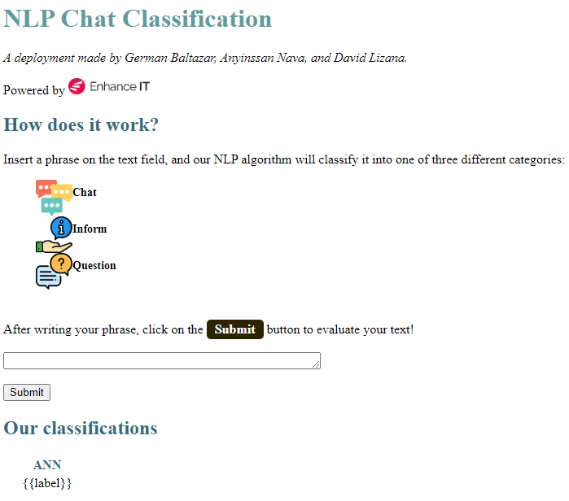
Our
API
Only capable of running the ANN model.
Technical difficulties for importing necessary libraries.
Classifies and determines the percentage of being classified

Slide 12
Conclusions
Similar performance was achieved using two different models.
Regularization, low dimensionality and dropout were import to avoid overfitting.
A higher performance could be achieved with most observations and more training time.
A more exhausted cleaning processing might help too.
Running on better equipment may prevent from running out of GPU use.
Successful deployment of the model using API.
The model could be a useful preliminary stage for an interactive communication platform with human beings.

Slide 13
Thanks!
TOP LINE
DIFFERENT ORNAMENTS
Do you have any questions?

Slide 14
Appendix
Dataset information 15
Data class distribution 16
Original sentence lengths 17
Pre-processed sentence lengths 18
ANN loss function 19
ANN accuracy comparison 20
ALBERT loss function 21
ALBERT accuracy comparison 22

Slide 15
Dataset Information
https://huggingface.co/datasets/silicone/tree/main/dummy/dyda_da/1.0.0
 | Training Set | Validation Set | Test Set
Original size | 87,170 | 8,069 | 7,740
Deleting duplicates | 72,391 | 7,682 | 7,469

Slide 16
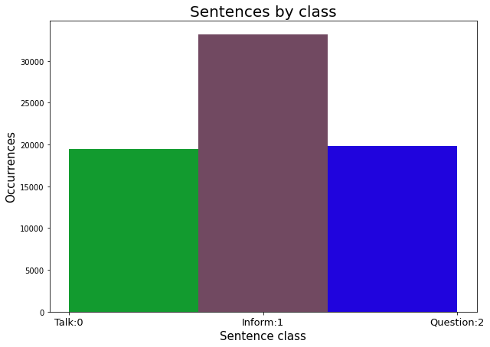
Data Class Distribution

Slide 17
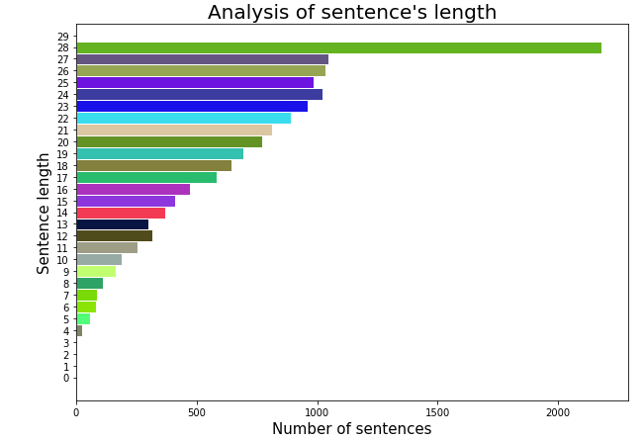
Original Sentence Lengths

Slide 18
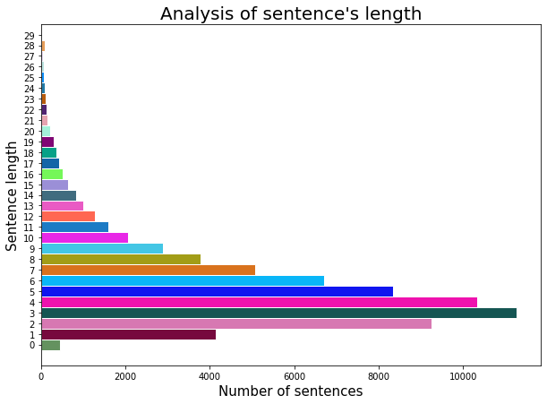
Pre-processed Sentence Lengths

Slide 19
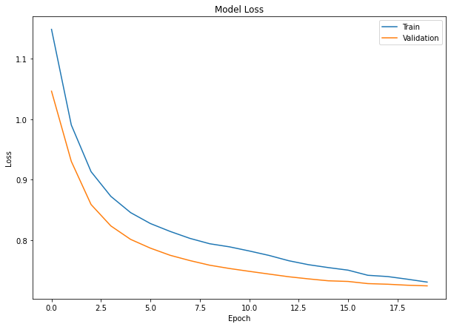
ANN Loss Function

Slide 20
ANN Accuracy Comparison
Training Set | Validation Set | Test Set
67.77% | 70.54% | 73.08%

Slide 21
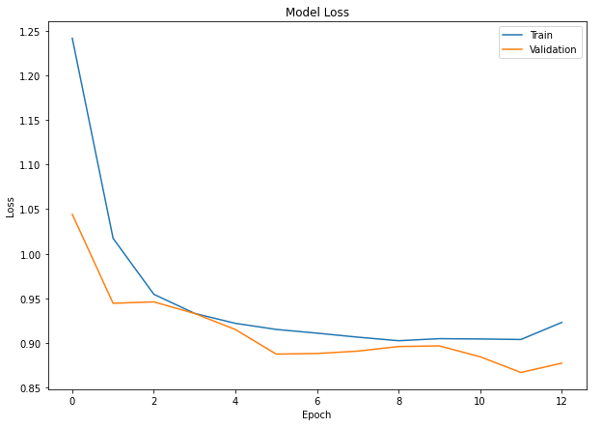
ALBERT Loss Function

Slide 22
ALBERT Accuracy Comparison
Training Set | Validation Set | Test Set
71.45% | 68.59% | 73.12%

